Slide 1
Recreating Nostalgic Computer Games in JavaScript
Sara Gorecki
@opheliasdaisies
Notes:
Hi and welcome!
Thanks to jQuery Conf
recreating computer games in the browser

Slide 2
Who I Am
@opheliasdaisies
Node Engineer at Penton Media
Flatiron School Graduate
Born and Raised in NYC
& I love video and computer games
Notes:
This is me!
I live in NYC - run Queens JS
went to Flatiron School
& now Node engineer at Penton
The thing about me most relevant to this talk - love video and computer games

Slide 3

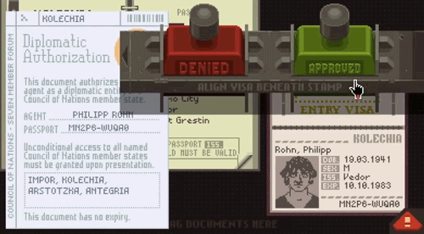
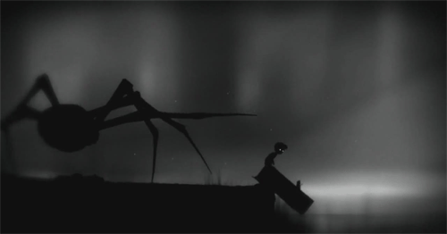
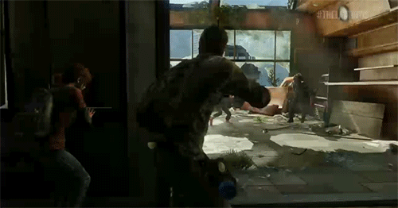
Computer Games are Awesome!
Notes:
So many kinds of games
Platformers and action-heavy games
Beautiful story-driven games - almost like watching a movie
Indie computer games with lightweight graphics
Games that have evolved - original Civ and Sim City
Classics like Mario & Pac Man

Slide 4
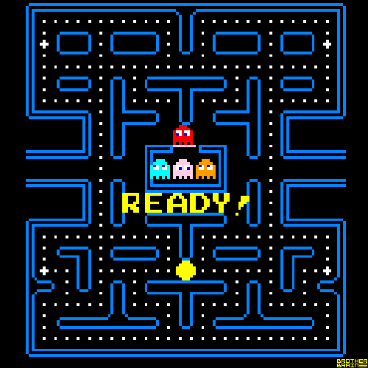
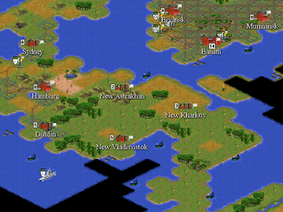
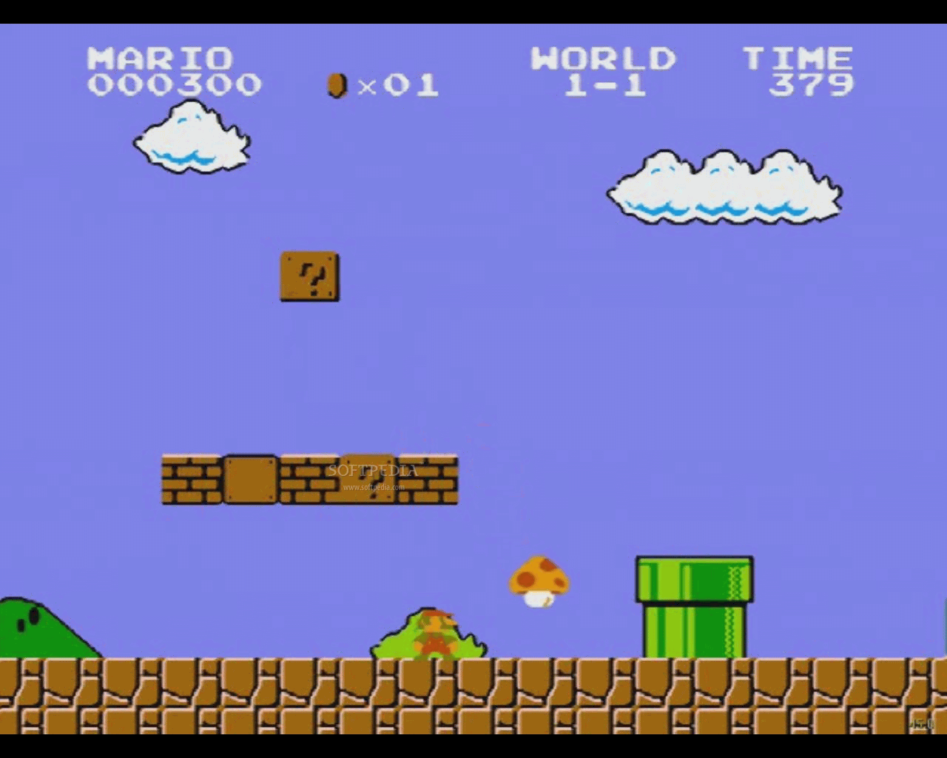
Computer Games are Awesome!
Notes:
So many kinds of games
Platformers and action-heavy games
Beautiful story-driven games - almost like watching a movie
Indie computer games with lightweight graphics
Games that have evolved - original Civ and Sim City
Classics like Mario & Pac Man

Slide 5
So what’s this talk about, anyway?
Logic patterns and planning a game
Rendering your game
The game engine event loop
Managing repeating elements (pieces, cards, etc.)
Perils and pitfalls (mistakes are okay)
Notes:
Build a game without having to worry about coming up with rules or story

Slide 6
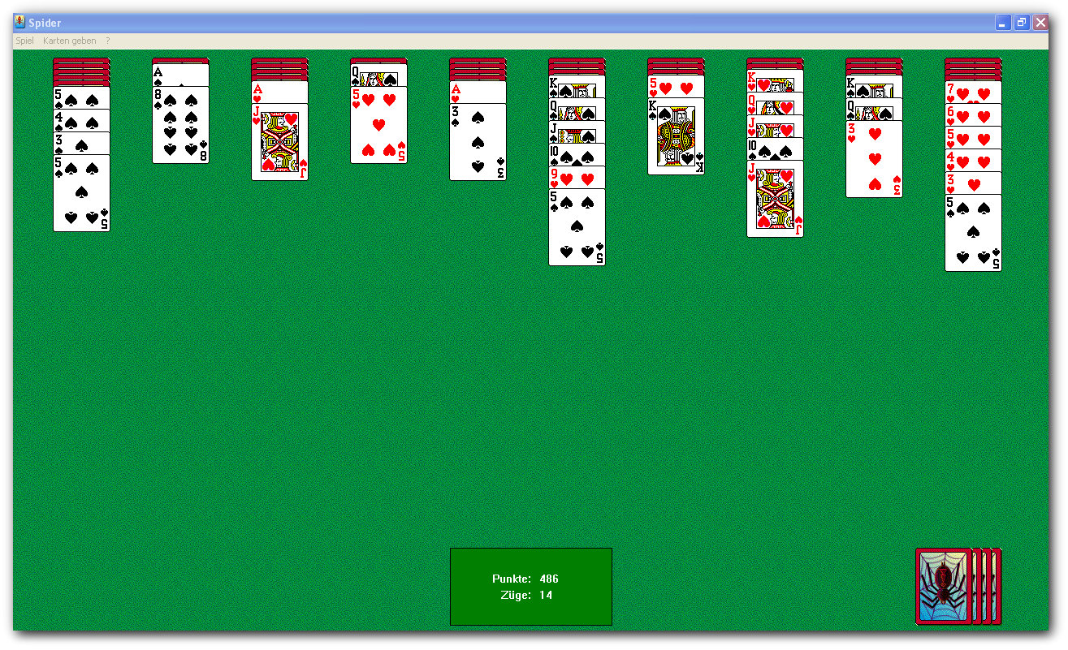
Let’s Talk Spider Solitaire
Notes:
Who’s played?
Got really popular with Windows XP, on some Unix systems 1989

Slide 7
The Rules
Remove all cards from the table
Cards can be stacked by value (ie. 2 on a 3)
Cards of the same suit can be moved together if they are of consecutive, ascending values
Additional cards can be dealt 10 at a time, but only if no columns are empty.
Notes:
Started by playing a lot of SS
Most of the rules have to do with moving the cards around
Refresher - stacking rules

Slide 8
The Deck
Two decks of cards, 54 dealt to start
Three Difficulty Levels, based on the number of suits
Each card has:
Value (1-13)
Face (A-K)
Suit
Color
Notes:
Each card has value and suit - important
Face and color - aesthetic

Slide 9
Planning the Game
Didn’t want to have to create cards each time
Spider Solitaire has no complex timings or animations
Everything in the game happens on page load or a click event
Notes:
Templating
Since SS slow-paced game based on click-events, perfect for a DOM-based game

Slide 10
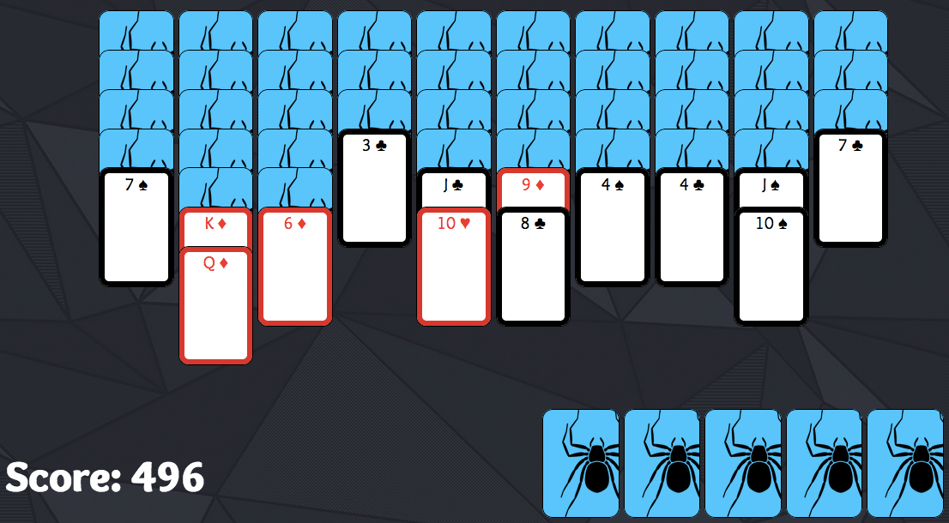

The States of Things
Active/Faceup Cards
Selected Cards
Notes:
Start by charting out the different states that cards could have
active/faceup - most of the visible cards
selected - any active card can become selected & all stacked will be
facedown - most of the cards at first, nothing can happen to them
reserve - dealt later 10 at a time
blocked - different suit on top of a card, can’t move that card

Slide 11

The States of Things
Facedown Cards
Notes:
Start by charting out the different states that cards could have
active/faceup - most of the visible cards
selected - any active card can become selected & all stacked will be
facedown - most of the cards at first, nothing can happen to them
reserve - dealt later 10 at a time
blocked - different suit on top of a card, can’t move that card

Slide 12

The States of Things
Reserve Cards
Notes:
Start by charting out the different states that cards could have
active/faceup - most of the visible cards
selected - any active card can become selected & all stacked will be
facedown - most of the cards at first, nothing can happen to them
reserve - dealt later 10 at a time
blocked - different suit on top of a card, can’t move that card

Slide 13

The States of Things
Blocked Cards
Notes:
Start by charting out the different states that cards could have
active/faceup - most of the visible cards
selected - any active card can become selected & all stacked will be
facedown - most of the cards at first, nothing can happen to them
reserve - dealt later 10 at a time
blocked - different suit on top of a card, can’t move that card

Slide 14
Let’s Break It Down
$(‘.card’)
$(‘.faceDown’)
$(‘.reserve’)
$(‘.selected’)
$(‘.blocked’)
Notes:
Made a different class for each state, charted what would happen on each click event
card - selects card only if not facedown or blocked, and if no other card is selected
facedown - if the card on top of it is moved, the class is removed
selected - will either move or be un-selected

Slide 15
Dealing the Deck
YAML file had all card data
Shuffled it and served it to the client
Each column is a div with class column
Each card is a div with child divs for the card properties
Dealt cards facedown
Notes:
Thin backend that read a YAML, shuffled, passed it all of to the client
‘poor man’s two-dimensional array’
Column divs, with card divs nested

Slide 16
Partials
Created partials so as to not re-create each card
Each card div has children with the classes ‘value’, ‘face’, ‘color’, ‘suit’
4 columns of 6 cards each 6 columns of 5 cards each
Notes:
To ‘deal’ the cards I just looped the appropriate number of times to create column and card divs, and positioned them with css

Slide 17
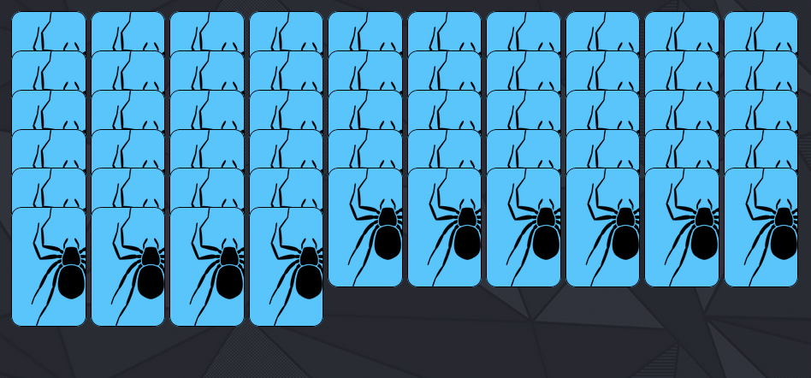
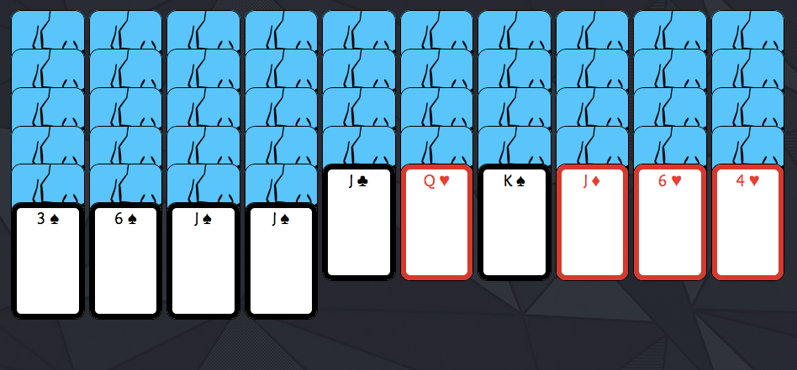
On to JavaScript!
Notes:
On doc load, use JS to flip over the top card in each column, and we’re ready to play!

Slide 18
On to JavaScript!
Notes:
On doc load, use JS to flip over the top card in each column, and we’re ready to play!

Slide 19
$(".board .column").on("click", ".card", function(){
var $this = $(this);
var $selected = $(".selected");
if(!$this.hasClass("faceDown") && !$this.hasClass("blocked")){
//for when nothing has been selected
if($selected.length == 0){
//select card and cards below
$this.addClass("selected");
$this.nextAll().addClass("selected");
} else {
var $firstSelected = $($selected[0]);
// for when cards have been selected
if($this.hasClass("selected")){
//remove selected if clicked on selected
$selected.removeClass("selected");
} else if (+$this.find(".value").text() == +$firstSelected.find(".value").text()+1){
var $blockedInCol = $firstSelected.prevAll(".blocked");
//turn uncovered card face-up
$selected.prev().removeClass("faceDown");
//unblock cards
unblockCards($blockedInCol);
//move selected card to new column if values allow it
$selected.appendTo($this.parent());
$(".card").removeClass("selected");
findCardsToRemove(this);
//block card when card is off-suit
if ($this.find(".suit").text().trim() != $firstSelected.find(".suit").text().trim()){
$firstSelected.prevAll().not(".faceDown").addClass("blocked");
}
//decrease score by 1
$(".score").text(Number($(".score").text() - 1));
}
}
}
});
(Don’t worry about it.)
Notes:
So let’s start playing!
Everything takes place in click events
(don’t worry about it)
the else has ALL the game logic

Slide 20
So Let’s Start Playing
IF a card on the board is clicked and it does not have the class faceDown, and it does not have the class blocked
and IF the length of selected cards is 0
Then we can add the selected class to the clicked card, and any cards below it in the column
ELSE the selected card is moved, or not
This is where ALL the game logic lives!
Notes:
So let’s start playing!
Everything takes place in click events
(don’t worry about it)
the else has ALL the game logic

Slide 21


Or… maybe not
$(‘.board .column .card’)
Notes:
Everything worked fine while I was only working with the cards on the board.
But, these reserve cards aren’t in the board class.

Slide 22
Or… maybe not
$(‘.board .column’).on(‘click’, ‘.card’, function());
Notes:
Everything worked fine while I was only working with the cards on the board.
But, these reserve cards aren’t in the board class.

Slide 23
So what about the else? The rest of the game logic.
When cards are selected, you can move them between columns by clicking again. (remove class selected and appendTo column)
Remove facedown class from the card underneath a card that has been moved
Notes:
This is great. We can select cards and move them between columns. But you can also do whatever you want.

Slide 24
Validating Moves
Find the numeric value (1-13) of the selected card with the greatest value.
The card clicked should have a value equal to the selected card +1.
If not, definitely an invalid move.
If the selected card and the card it is placed on have different suits, all cards above selected are given the class ‘blocked’. (But only if not facedown!)
Notes:
Since all data stored in DOM, I’m literally using jQ to find the element I want and pull out the val
Cards actually have 4 children divs w/ properties
(hint: really easy to cheat)

Slide 25
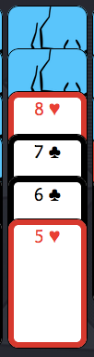
What is blocked must be unblocked
When a card is moved off the column, look at all the cards in that column with the ‘blocked’ class
The top card always will become unblocked
Look at each card going up the column, check the suit and value
Stop once there’s a card that can’t be unblocked
Notes:
Remember that with the reserve cards, you can(will) have cards that are spontaneously blocked.
ie. could have valid cards 3-8 on-suit, but when you deal the reserve you may need to block (and hopefully later unblock) all of those cards together.
Element of randomness & unpredictability.

Slide 26
How to Win
Remove all the cards!
When a card is moved, check the column for a King
If there’s a King, check each descending card for a value and suit match
If you reach an Ace, congratulations!
(Don’t forget to turn the card under the King face-up.)
Notes:
A little tedious to keep pulling all this info out of the DOM, but it happened and worked and i think its pretty awesome

Slide 27
Let’s Play!
Demo Time!
spider-solitaire.herokuapp.com

Slide 28
So… What now?
By building Spider Solitaire, I learned how to make a DOM-based game.
Appreciated the power of partials and templating.
Learned how to think about general game logic.
Made a DOM-based game!
Notes:
SS DOM-based
really good at DOM traversal
learned how to think about building a game & game logic

Slide 29
So… What now?
What if you wanted to make a game that included animation?
What if you wanted to make a game that had multiple things happen at once?
What if you wanted to make a game that relied on timing?
Notes:
But storing all your everything in DOM can be limiting
great for SS
what if animations/speed/timing/complexity
need to do more and learn other game-building techniques

Slide 30
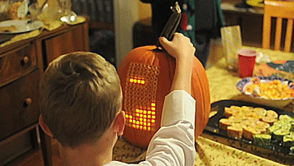
Time for….. Tetris!

Slide 31
The Rules
Pieces are randomly generated
Pieces move down at regular intervals
Pieces can stack
Pieces can rotate and move left/right on player input
Pieces cannot overlap other pieces or move off the grid
Notes:
pieces fall
pieces rotate
rows vanish

Slide 32
The Approach
New challenges
Constant animation
Multiple things happen at once
New approach
Separate the game logic from the DOM
Have an event loop for the game
Notes:
a lot more going on than in SS
pieces can move multiple directions at once
pieces can morph
things are always moving
remove game logic from DOM

Slide 33
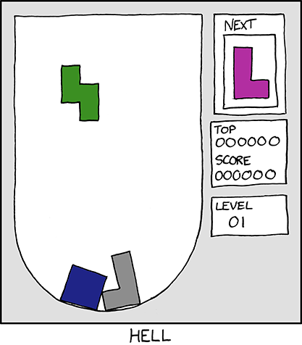
The Pieces and the Board
Notes:
Used JS Objects
separated into pieces and boards

Slide 34
The Pieces and the Board
The Piece Constructor
Has a shape, chosen at random
Defaults to the configuration at Index 0
Is aware of the board it belongs to
Knows its starting coordinates on the board (midpoint on row 0)
Tracks if a piece is frozen
The Board Constructor
The grid - a two-dimensional array, initially all undefined
Has an active piece
Knows if game is active
Controls the speed of the game, both rendering frequency and the speed at which pieces fall
Notes:
Used JS Objects
separated into pieces and boards

Slide 35
Rendering The Board
Tables!
(jk)
Notes:
Using handlebars independent of a framework
Reminded me of the game of life
Iterate over the grid to find each row - make a div
Iterate over each row to find each tile - make a div
Use css to set width/height/color for each tile
If active change the color to red
And we’re never going to have to worry about this again. The body of my html is about 20 lines.

Slide 36
Rendering The Board
Handlebars templates!
In the Board constructor we compile the board
this.boardTemplate = Handlebars.compile($(‘#board').html())
$(‘.board').html(this.boardTemplate(this));
In our html we iterate over our grid with {{#each }}
{{#if . }} apply the class ‘active’
Notes:
Jen — table
Using handlebars independent of a framework
Reminded me of the game of life
Iterate over the grid to find each row - make a div
Iterate over each row to find each tile - make a div
Use css to set width/height/color for each tile
If active change the color to red
And we’re never going to have to worry about this again. The body of my html is about 20 lines.

Slide 37
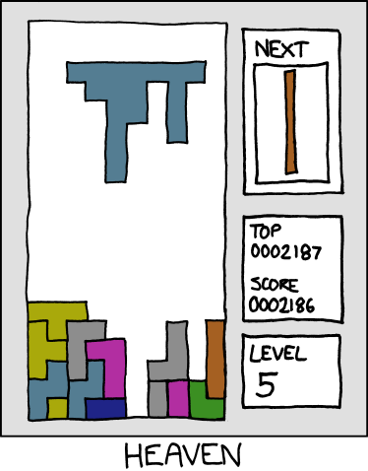
The Pieces
Notes:
7 different pieces
Created an array of objects, with each object containing the properties for a type of piece, and charted out each of their positions in a multi-dimensional array
If a tile => true
If no tile => undefined

Slide 38
The Pieces
Notes:
7 different pieces
Created an array of objects, with each object containing the properties for a type of piece, and charted out each of their positions in a multi-dimensional array
If a tile => true
If no tile => undefined

Slide 39
The Pieces
Notes:
7 different pieces
Created an array of objects, with each object containing the properties for a type of piece, and charted out each of their positions in a multi-dimensional array
If a tile => true
If no tile => undefined

Slide 40
The Pieces
Notes:
7 different pieces
Created an array of objects, with each object containing the properties for a type of piece, and charted out each of their positions in a multi-dimensional array
If a tile => true
If no tile => undefined

Slide 41
The Pieces
Notes:
7 different pieces
Created an array of objects, with each object containing the properties for a type of piece, and charted out each of their positions in a multi-dimensional array
If a tile => true
If no tile => undefined

Slide 42
The Pieces
Notes:
7 different pieces
Created an array of objects, with each object containing the properties for a type of piece, and charted out each of their positions in a multi-dimensional array
If a tile => true
If no tile => undefined

Slide 43
The Pieces
Notes:
7 different pieces
Created an array of objects, with each object containing the properties for a type of piece, and charted out each of their positions in a multi-dimensional array
If a tile => true
If no tile => undefined

Slide 44
The Pieces
Notes:
7 different pieces
Created an array of objects, with each object containing the properties for a type of piece, and charted out each of their positions in a multi-dimensional array
If a tile => true
If no tile => undefined

Slide 45
The Game Loop
There are two event loops happening in Tetris
The rendering of the game
The movement of the pieces
Can use setInterval to call a ‘tick’ function - I set the interval for 50 milliseconds
Inside that ‘tick’ function, I call a function to render the grid as it exists at that moment
Notes:
Now we have our basic components, let’s start putting it all together
Two independent event loops happening - rendering game & things happening don’t have to happen together

Slide 46
Ticking Along
There are also two tick functions
The board tick
The piece tick
Notes:
Every 50 ms the game ticks
The game tick handles adding new pieces, telling the active piece to ‘tick’, removing complete rows, and rendering the board.
The piece tick is responsible for moving the piece left and right, moving the piece down faster, rotating the piece, and adding and removing itself from the board at a specific location.

Slide 47
Adding a Piece
The board checks to see if it already has an active piece, if not it generates a new Piece
We look at the piece, and iterate over each row and column
If that location is undefined, skip it. Otherwise, find the corresponding location on the board.
Notes:
if board has no piece, it generates a new Piece(this)
remember, the piece knows where on the board its upper-left corner is located
iterate over the piece template by row and column and if that location is part of the piece, chart it to the grid

Slide 48


Adding a Piece
Notes:
if board has no piece, it generates a new Piece(this)
remember, the piece knows where on the board its upper-left corner is located
iterate over the piece template by row and column and if that location is part of the piece, chart it to the grid

Slide 49
Adding a Piece
Notes:
if board has no piece, it generates a new Piece(this)
remember, the piece knows where on the board its upper-left corner is located
iterate over the piece template by row and column and if that location is part of the piece, chart it to the grid

Slide 50
Adding a Piece
Notes:
if board has no piece, it generates a new Piece(this)
remember, the piece knows where on the board its upper-left corner is located
iterate over the piece template by row and column and if that location is part of the piece, chart it to the grid

Slide 51
Removing a Piece
It doesn’t matter where the piece is
Iterate over the entire board
Remove any tile with a value of true
Notes:
The only tiles with the value ‘true’ are the active pieces

Slide 52
Moving a Piece Down
Our piece knows its coordinates
We just need to change the coordinates and re-render
Notes:
Once we have a piece on the board, move the coordinates down by one row
Remove the piece
Add it in the new location
Re-draw

Slide 53
What does that leave us with?
Each time the board ‘ticks’:
It can add an active piece
It tells the active piece to tick
It re-renders the board
Each time the piece ‘ticks’:
It moves coordinates down by one
It removes itself
It adds itself at the new coordinates
Notes:
each tick ’50 ms’
new piece is added if needed
the active piece’s coordinates are moved down by 1 row
the piece is removed from the old location on the grid
added to the new location
re-render board

Slide 54
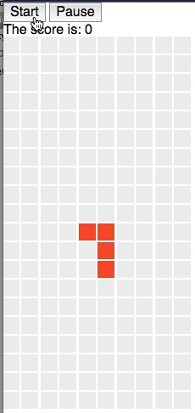
What does that leave us with?
Notes:
each tick ’50 ms’
new piece is added if needed
the active piece’s coordinates are moved down by 1 row
the piece is removed from the old location on the grid
added to the new location
re-render board

Slide 55
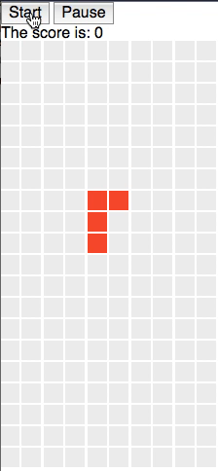
Stacking Pieces
We need to check and see if a piece can move down
Only need to check the bottom row and compare against the height of the board
If a piece reaches the bottom, we ‘freeze’ it.
Remove activePiece from board
Set the value to ‘frozen’
Notes:
Can’t freeze a piece by setting the value to false because it won’t render {{#if .}} checks for truth values.
Problem: pieces overwrite other pieces. Not stacking.
Iterate over the piece just like when we added the piece to the grid, except for the coordinates, we’re looking at the one below where the shape actually is

Slide 56
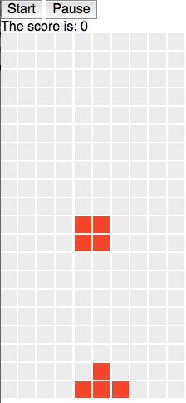
Stacking Pieces
Evaluate piece, checking to see if the tile in the row below the active piece is frozen
Notes:
Can’t freeze a piece by setting the value to false because it won’t render {{#if .}} checks for truth values.
Problem: pieces overwrite other pieces. Not stacking.
Iterate over the piece just like when we added the piece to the grid, except for the coordinates, we’re looking at the one below where the shape actually is

Slide 57
Keyboard Input
Move left or right or down really fast or rotate on keydown
But, instead of moving right away, we’re going to use the key press to set the game state
board.input = { right: false, left: false, down: false, up: false };
Notes:
Finally back to using jQuery!
We want to be able to respond to keyboard input faster than the pieces are moving down
Compare/contrast using state to SS (direct manipulation)
Change the input to true on keydown, and change back to false on keyup
similar to how gamepad api works

Slide 58
Moving
Moving from keyboard input is based on the speed of the ‘tick’, not the speed at which the piece moves down
Calculating moving right and left are similar to moving down
Move down on every tick while board.input.down is true
Notes:
Right/Left: Check for frozen pieces and check for the edge
Down: Instead of comparing the time to the last move, move on every tick

Slide 59
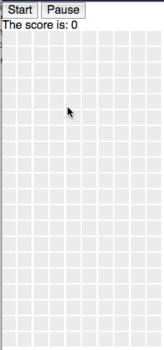
Moving
Notes:
Right/Left: Check for frozen pieces and check for the edge
Down: Instead of comparing the time to the last move, move on every tick

Slide 60
Rotating
Get input same as other directional keys - state stored in board.input
Each piece has an array of all orientations
Notes:
‘z’ shape has 2
square has 1
L & T most complicated - 4

Slide 61
Rotating
Get input same as other directional keys - state stored in board.input
Each piece has an array of all orientations
We just need to change the current orientation to the next in the array, and loop back around
Notes:
Since rotation will happens on the piece ‘tick’, the piece will then be removed and re-drawn with the new orientation
The coordinates don’t change so the upper-left corner stays in the same place
One other thing - slow down the rotation by comparing current time to the time of last rotation - only every 100 ms

Slide 62
Can you even rotate?
Need to validate your rotations
Check for a ‘wall jump’ - if piece will go off the board, shift the coordinates to keep it inside
Compare the next orientation to the board grid to see if a frozen piece is already there
Notes:
Only change the coordinates and current orientation if the conditions are met, otherwise don’t allow the rotation

Slide 63
Can you even rotate?
Need to validate your rotations
Check for a ‘wall jump’ - if piece will go off the board, shift the coordinates to keep it inside
Compare the next orientation to the board grid to see if a frozen piece is already there
Notes:
don’t want to move off grid or into another piece
‘wall jump’
Only change the coordinates and current orientation if the conditions are met, otherwise don’t allow the rotation

Slide 64
Winning!
Delegate this back to the board
Iterate over all the rows and columns
If you get through a row without finding an un-frozen tile, that row is removed
A new row is added to the top of the grid
Notes:
Remove row with splice
Add row with unshift
Issue with undefined - can’t iterate

Slide 65
Let’s Play!
Demo Time!
opheliasdaisies.github.io/tetris

Slide 66
Next Steps
Add color
Add losing
Add score and row count
Add levels with different speeds
Add piece preview

Slide 67
Go make games!
Notes:
Games are a lot of fun, to play and to build.
If you’ve ever wanted to build a game, just go do it.

Slide 68
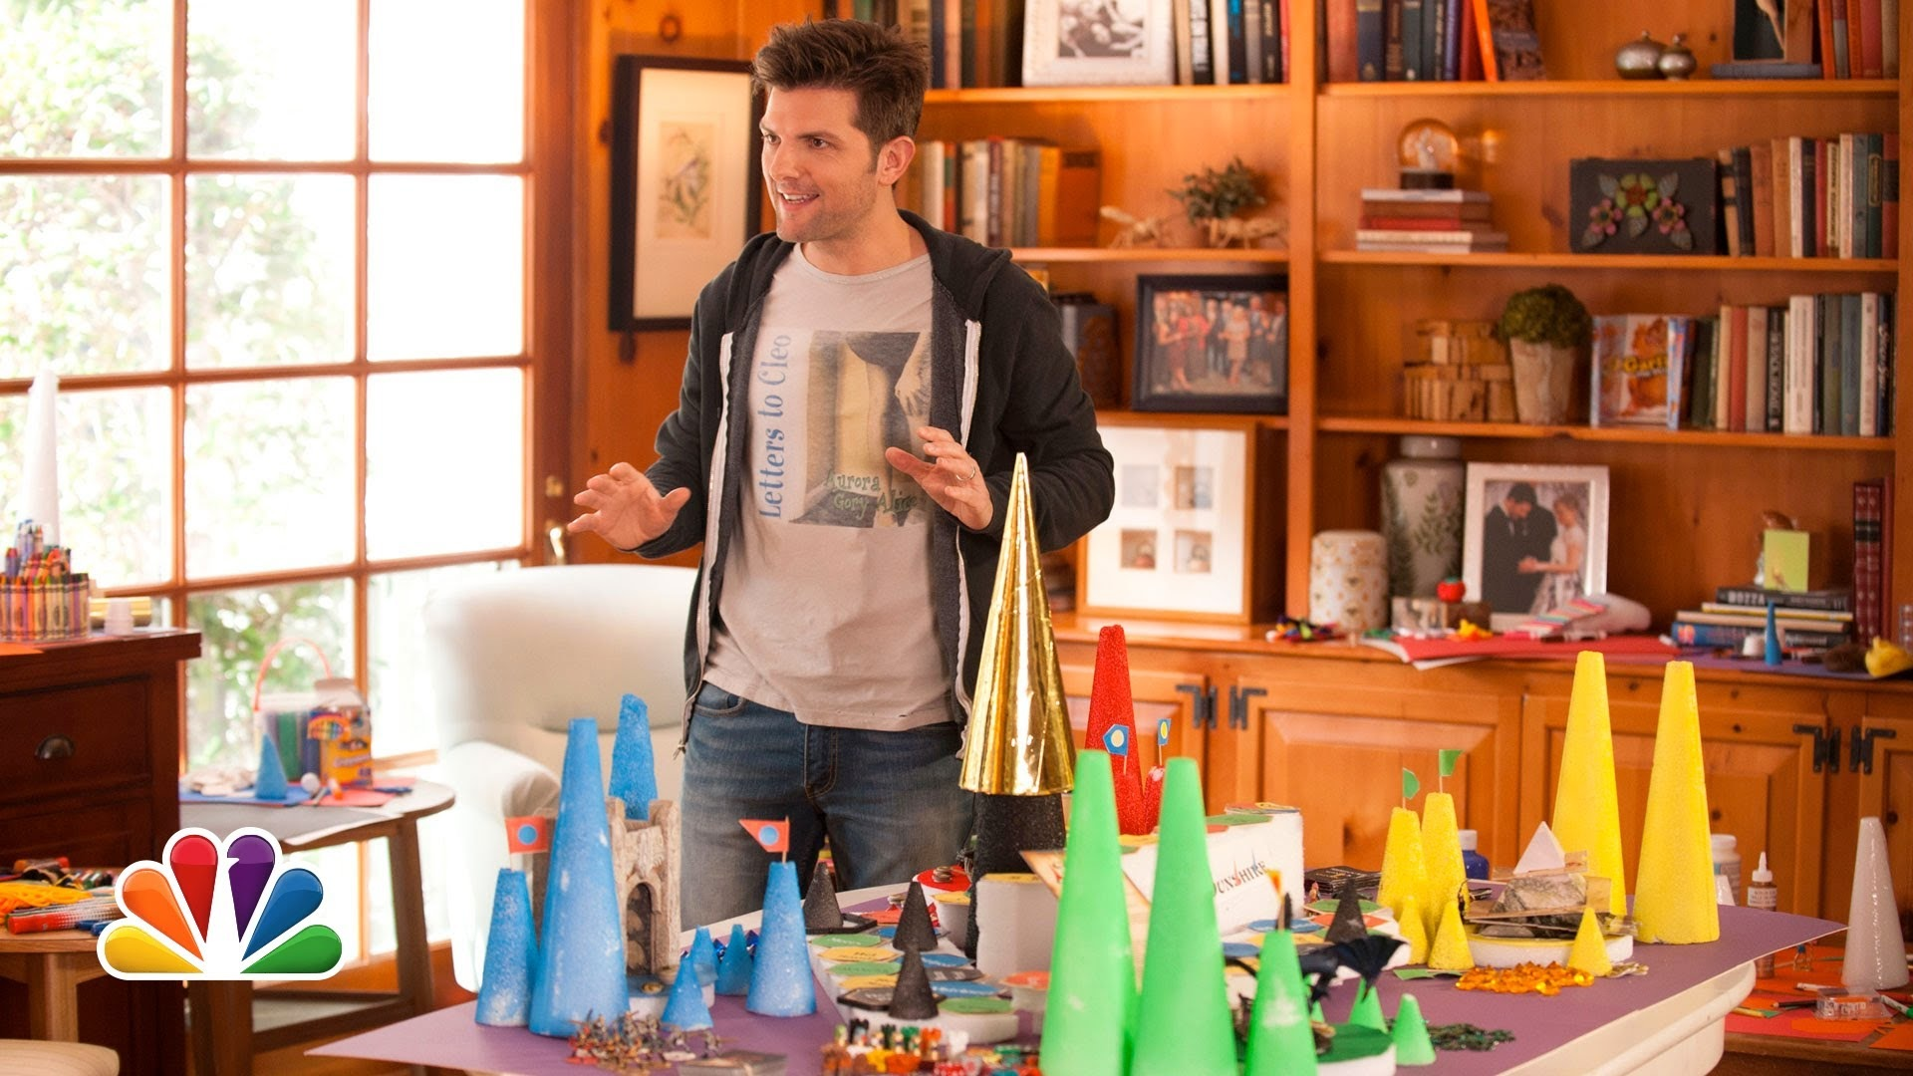
Notes:
Games are a lot of fun, to play and to build.
If you’ve ever wanted to build a game, just go do it.

Slide 69
Thank You!
Sara Gorecki @opheliasdaisies
spider-solitaire.herokuapp.com opheliasdaisies.github.io/tetris

